Slide 1
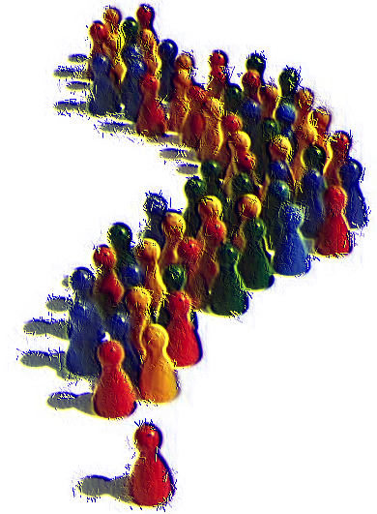
Followers of Christ
Luke 9:57-62
Notes:
Discipleship requires sacrifice on the part of the follower. This is especially true as we consider what our Lord expects from us!
Disciple – One who learns. However, the concept indicates that such a “learner” adopts or adheres to what he “learns”
(John 8:31-32), “Then Jesus said to those Jews who believed Him, " If you abide in My word, you are My disciples indeed. ³² And you shall know the truth, and the truth shall make you free.“
What kind of followers of Jesus are we?
(Adapted from a Joe Price outline from The Spirit’s Sword, June 2003)

Slide 2
What kind of followers are we?
Those who follow from a distance (Matthew 26:58)
Notes:
(Matthew 26:57-58), “And those who had laid hold of Jesus led Him away to Caiaphas the high priest, where the scribes and the elders were assembled. ⁵⁸ But Peter followed Him at a distance to the high priest's courtyard. And he went in and sat with the servants to see the end.”
Not to be too critical of Peter’s failures in this, he was bolder than others
However, this was a low point, as his lack of courage on this occasion led to his denying his Lord.
(James 4:7-8), “Therefore submit to God. Resist the devil and he will flee from you. ⁸ Draw near to God and He will draw near to you. Cleanse your hands, you sinners; and purify your hearts, you double-minded.”

Slide 3
What kind of followers are we?
Those who follow from a distance (Matthew 26:58)
The critical follower (John 12:1-6)
Notes:
(John 12:1-6) READ
Lazarus had impure motives
He was a thief, and coveted the money
Regardless of motive, this type of follower is never satisfied, always complaining.
Note: They were not complaining about Jesus, but bickering about others!
Mark’s account: (Mark 14:4,5), “But there were some who were indignant among themselves, and said, "Why was this fragrant oil wasted? ⁵ For it might have been sold for more than three hundred denarii and given to the poor." And they criticized her sharply.”

Slide 4
What kind of followers are we?
Those who follow from a distance (Matthew 26:58)
The critical follower (John 12:1-6)
The fussy (factious) follower (Galatians 5:15)
Notes:
(Galatians 5:15), “But if you bite and devour one another, beware lest you be consumed by one another!”
Factiousness is destructive to all. Both the victim, and the victimizer
It is a great cause of the loss of souls
(Unity is called for) (Colossians 3:14-15), “But above all these things put on love, which is the bond of perfection. ¹⁵ And let the peace of God rule in your hearts, to which also you were called in one body; and be thankful.”

Slide 5
What kind of followers are we?
Those who follow from a distance (Matthew 26:58)
The critical follower (John 12:1-6)
The fussy (factious) follower (Galatians 5:15)
The fearful follower (Matthew 8:23-27)
Notes:
(Matthew 8:23-27) READ
To be fair, the text indicates they did not have a full understanding of the nature of Christ’s power and authority!
However, we do, and we have no reason to fear, with Christ on our side!
(2 Peter 1:5a), “But also for this very reason, giving all diligence, add to your faith virtue,…”
Virtue – Courage
We must maintain our boldness and courage in the face of persecution and the challenges to our faith!

Slide 6
What kind of followers are we?
Those who follow from a distance (Matthew 26:58)
The critical follower (John 12:1-6)
The fussy (factious) follower (Galatians 5:15)
The fearful follower (Matthew 8:23-27)
The obedient follower (Luke 6:46)
Notes:
(Luke 6:46-49), “But why do you call Me 'Lord, Lord,' and not do the things which I say? ⁴⁷ Whoever comes to Me, and hears My sayings and does them, I will show you whom he is like: ⁴⁸ He is like a man building a house, who dug deep and laid the foundation on the rock. And when the flood arose, the stream beat vehemently against that house, and could not shake it, for it was founded on the rock. ⁴⁹ But he who heard and did nothing is like a man who built a house on the earth without a foundation, against which the stream beat vehemently; and immediately it fell. And the ruin of that house was great.“
It is not possible to style yourself genuinely as a follower of Christ if you do not obey what you learn!
(James 1:21-22), “Therefore lay aside all filthiness and overflow of wickedness, and receive with meekness the implanted word, which is able to save your souls. ²² But be doers of the word, and not hearers only, deceiving yourselves.”

Slide 7
What kind of followers are we?
Those who follow from a distance (Matthew 26:58)
The critical follower (John 12:1-6)
The fussy (factious) follower (Galatians 5:15)
The fearful follower (Matthew 8:23-27)
The obedient follower (Luke 6:46)
The sacrificial follower (Luke 5:11, 27-28)
Notes:
(Peter, Andrew, James and John, astonished at their catch at Jesus’ instructions) (Luke 5:11, 27-28), “So when they had brought their boats to land, they forsook all and followed Him.”
(27-28), “After these things He went out and saw a tax collector named Levi, sitting at the tax office. And He said to him, " Follow Me." ²⁸ So he left all, rose up, and followed Him.”
(Philippians 3:7-8), “But what things were gain to me, these I have counted loss for Christ. 8 Yet indeed I also count all things loss for the excellence of the knowledge of Christ Jesus my Lord, for whom I have suffered the loss of all things, and count them as rubbish, that I may gain Christ.”

Slide 8
God wants us to be Enduring Followers!
Matthew 10:21-22
Notes:
(Matthew 10:22), “Now brother will deliver up brother to death, and a father his child; and children will rise up against parents and cause them to be put to death. ²² And you will be hated by all for My name's sake. But he who endures to the end will be saved.
(Hebrews 10:35-39), “Therefore do not cast away your confidence, which has great reward. ³⁶ For you have need of endurance, so that after you have done the will of God, you may receive the promise: ³⁷ "For yet a little while, and He who is coming will come and will not tarry. ³⁸ Now the just shall live by faith; but if anyone draws back, my soul has no pleasure in him.“ ³⁹ But we are not of those who draw back to perdition, but of those who believe to the saving of the soul.”

